Slide 1

SITE CONNECTIVITY CHECKER
Abhigyan Mishra
20bcs6066
Aiml1-b

Slide 2
CONTENT
1
ABOUT
2
NEED OF THE APP
3
APPLICATIONS USED
2020
OUTPUT

Slide 3
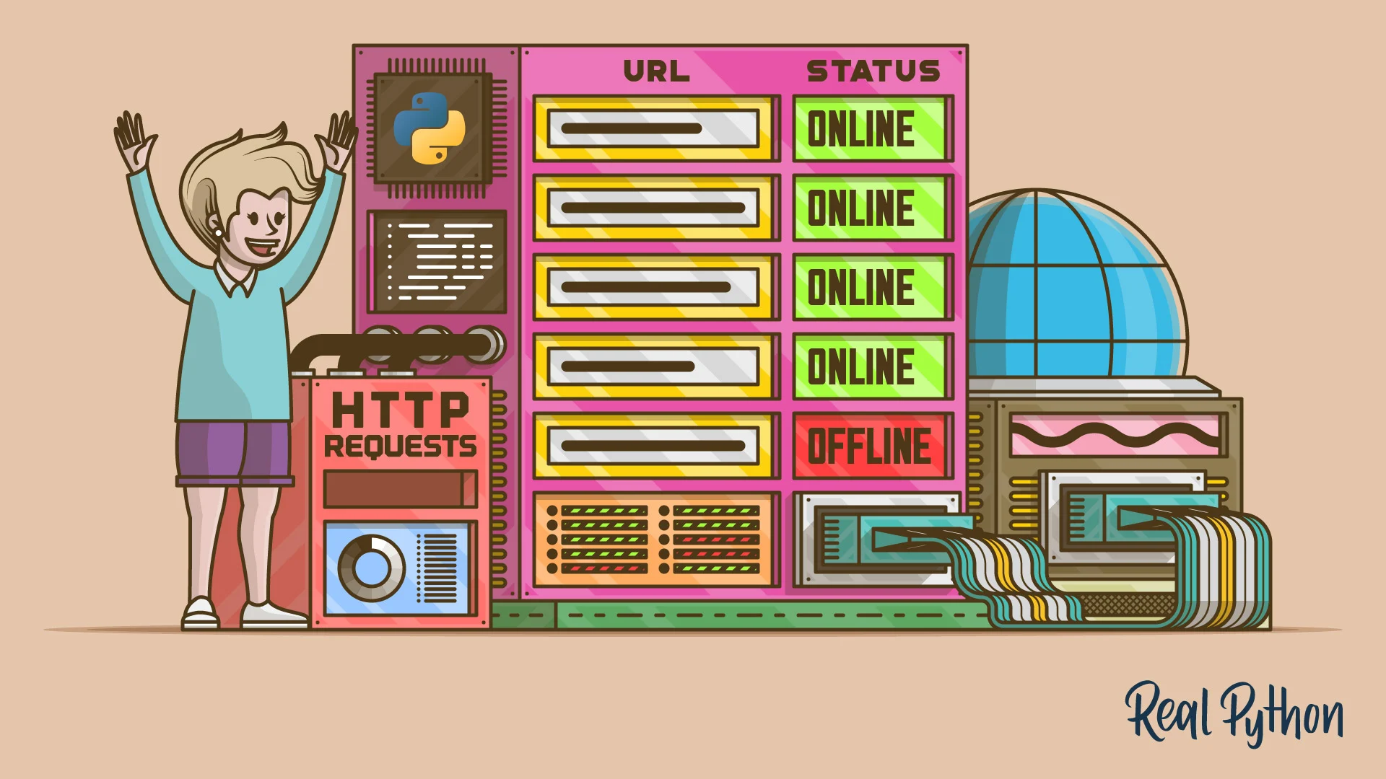

Slide 4
ABOUT
The Site Connectivity Checker visits a URL and returns the status of the URL: it is either live or not. We shall be using the Pandas Library for exatracting website data from a csv file
When you visit a URL, you expect to get the requested pages on Our browser. But this is not always the case. Sometimes, sites can be down, so you won’t get the desired results. Instead, you’ll be presented with error messages. You can keep trying a site that is down, till it comes up and you get the information you need.
This is where the Site Connectivity Checker project comes in. The Site Connectivity Checker visits a URL and returns the status of the URL: it is either live or not. The Site Connectivity Checker will visit the URL at intervals, returning the results of each visit.
Instead of manually visiting a URL, a Site Connectivity Checker can do all of that manual work for you. This way, you’ll only get the results of the check without having to spend time on the browser, waiting for the site to go live.

Slide 5
PROJECT OVERVIEW
Building a site connectivity checker in Python is an interesting project to level up Our skills. With this project, you’ll integrate knowledge related to handling HTTP requests, creating command-line interfaces (CLI), and organizing Our application’s code using common Python project layout practices.

Slide 6
PROJECT OVERVIEW
Our website connectivity checker app will provide a few options through a minimal command-line interface (CLI).
Here’s a summary of these options:
-u or --urls allows you to provide one or more target URLs at the comment line.
-f or --input-file allows you to supply a file containing a list of URLs to check.
-a or --asynchronous allows you to run the connectivity checks asynchronously.
By default, Our application will run the connectivity checks synchronously. In other words, the app will perform the checks one after another

Slide 7
PREREQUISITES
The project that you’ll build in this tutorial will require familiarity with general Python programming.
Additionally, it’ll require
basic knowledge of the following topics:
Handling exceptions in Python
Working with files, the with statement, and the pathlib module
Handling HTTP requests with standard-library or third-party tools
Creating CLI applications with the argparse module
Using Python’s asynchronous features

Slide 8
APPLICATION USED
PYTHON 3
Python 3 is a newer version of the Python programming language which was released in December 2008. This version was mainly released to fix problems that exist in Python 2. The nature of these changes is such that Python 3 was incompatible with Python 2. It is backward incompatible.
Some features of Python 3 have been backported to Python 2.x versions to make the migration process easy in Python 3. As a result, for any organization who was using Python 2.x version, migrating their project to 3.x needed lots of changes. These changes not only relate to projects and applications but also all the libraries that form part of the Python ecosystem.

Slide 9
THANKYOU!

